Slide 1

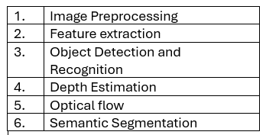
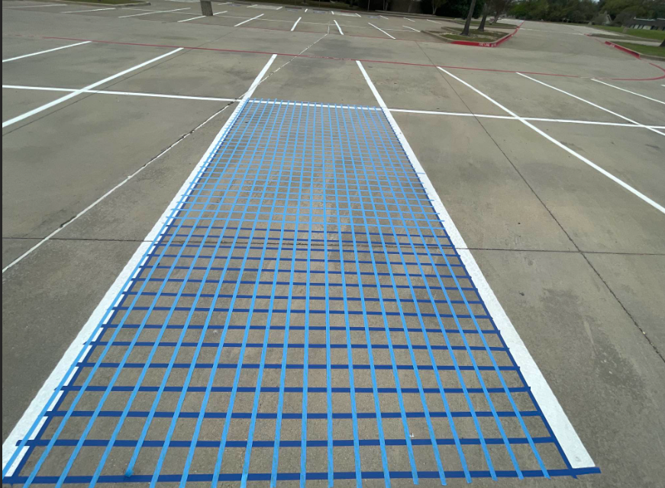
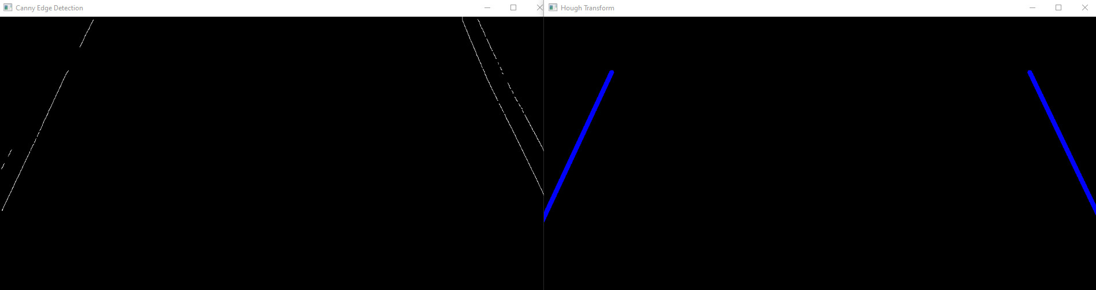
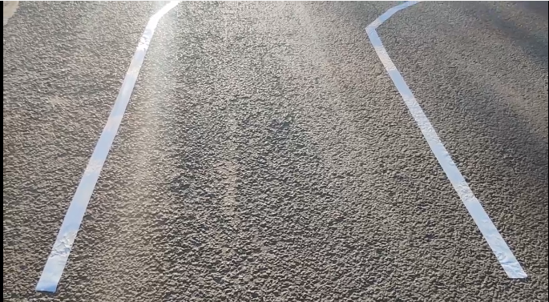
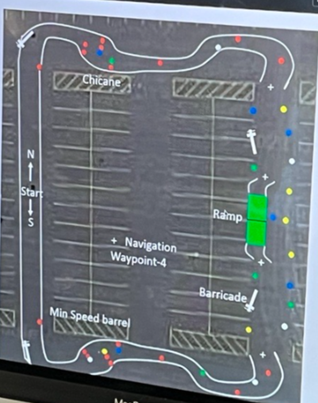
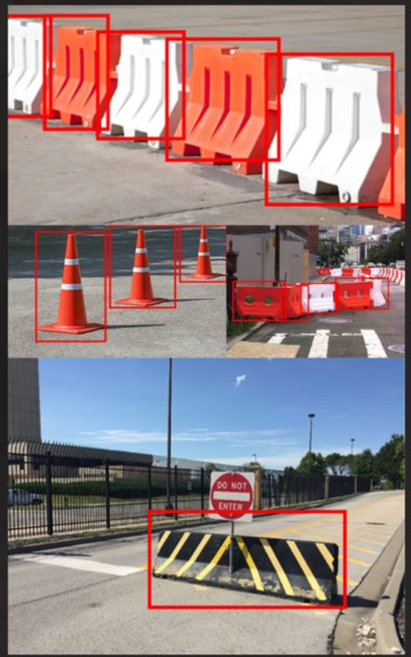
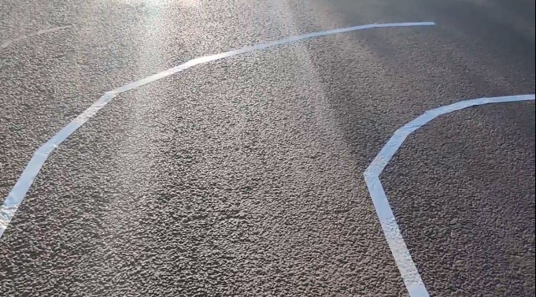

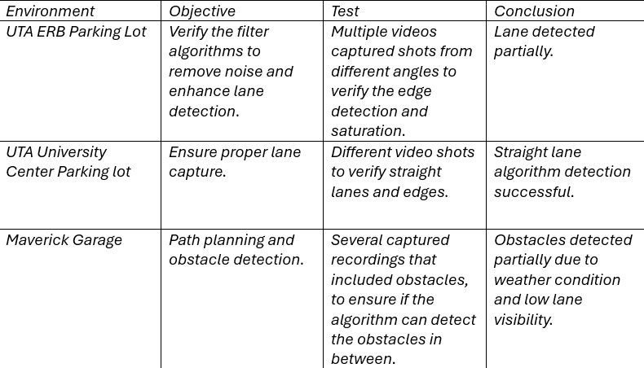
IGVC Ground Vehicle
J.Caetano, B.Bowles, S.Dayani, T.Nayyar, W.Periman
Dr. Mcmurrough
CSE Senior Design
Executive Summary
Experimental Setup
Experimental Results
The project aims to develop a modular computer vision system for autonomous vehicles, specifically for the IGVC (Intelligent Ground Vehicle Competition) vehicle representing The University of Texas at Arlington in the competition. Utilizing advanced computer vision and LIDAR technologies, this project is a scalable and specific computer vision system attuned to the IGVC competition requirements and test course, allowing navigation through the course by accurately identifying and avoiding obstacles, whilst staying on track using lane detection. Lane detection utilizing canny edge detection, filtering noise through erosion and dilation, and finding the edge using gaussian blur. For object recognition, YOLOv8 was used due to its performance and accuracy through a training model. Both lane detection and object recognition outputs a dot matrix as depth data to the path planning team.
Curved Lane​
Software setup for the IGVC vehicle would be include certain libraries (OpenCV). Development environment includes Python as the main programming language, ROS2 on Raspberry PI 4 and several algorithms to test the provided data and generate the required output. YOLOv8 will be implemented for object recognition.
Filtered images and clearly defined lines show the lane detection at work. The same system is used to see 'potholes' or sufficient noise in the image to warn of oncoming ground-level obstacles, as well.
Algorithms & Function's
Matrix Setup
Lane Detection
Object recognition is 85% confident to correctly identify the object such as obstacles, potholes and ramps.
Straight lane
Curved Lane
Automation Detection
Object Recognition using YOLOv8
Background
Experimental Test Plan
Conclusions
The Intelligent Ground Vehicle Competition (IGVC) is a yearly engineering competition that tasks teams with designing and creating a robot that can navigate a course without hitting any obstacles. We are one of three teams working on UTA's vehicle this iteration. Our focus is on the lane and object detection side of things. Competing and innovating for this competition is necessary since autonomous vehicles have the potential to bring about unprecedented leaps forward in road and vehicle safety, (McGinness) According to tests conducted by AAA in June 2022, the company reported that the future of autonomous vehicles is a long way off as their tests found that safety features designed to prevent crashes failed in multiple situations. That is why investment and support in this project and its development efforts are paramount
The goal of this test plan was to carry out several tests at multiple locations to verify the proper functionality of our algorithms, apply several filters to remove noise, enhance the saturation and ensure data validation.
Using well-known computer vision techniques and algorithms such as canny edge detection, Hough transforms, and YOLO, our team has been able to come up with lane and object detection solutions that run efficiently and will allow the IGVC vehicle to properly navigate through various paths successfully. This challenge taught us a great deal about the field of computer vision and how to work with tools such as Python, OpenCV, and NumPy to accomplish intricate computer vision tasks. We plan to continue to develop our methods and algorithms to make them more robust and better able to deal with more challenging conditions like lane curvature, object depth, inclement weather conditions, and other unpredictable and atypical road conditions. We greatly appreciate our professor, Dr. Christopher McMurrough, who has been extremely supportive and helpful throughout this learning process.
Carried out test's and their output's
References
Chris McGinness. Fully autonomous vehicles still a long way off, report finds, 2022
Object recognition will be training model of containing obstacle inputs such as cones, potholes and ramps. Expected confidence value is 90%.

